Slide 1




Predictive Analytics of US Airline Flight Delays
Karan Kashyap | Lester Pereira | Prasad Revalkar

Slide 2
Table of Content
Project Overview
Dataset Details
Data Exploration
Methodology
Results
Conclusion

Slide 3
Project Overview
MOTIVATION:
According to the International Air Transport Association, there would be nearly 3.6 billion annual passengers in 2016.
Delayed flights affect the Airline Company in terms of revenue, profit and reputation.
According to Joint Economic Committee report the annual cost of domestic flight delays to the US economy was estimated to be $31-40 billion USD in 2007.
Choosing an airline with the least delay is a challenging task.

Slide 4
Project Overview
GOAL:
According to the US department of transportation a flight is considered to be delayed if it is delayed by 15 minutes or more.
Thus in this project we are considering a 15 minute threshold to predict whether a flight will be delayed or not by using different classification algorithms.

Slide 5
Dataset Details
The dataset was obtained from the website of the Bureau of Transportation Statistics http://www.transtats.bts.gov/DL_SelectFields.asp?Table_ID=236&DB_Short_Name=On-Time
The Dataset consist of 14374 domestic flight details of the year 2015 , consisting of 25 variables.
It includes variables like origin city, destination city, origin airport, destination airport, year, day of the week, delay minutes etc.

Slide 6
Data Processing
For simplifying the dataset we have considered only 25 variables out of the total 110 variables.
We have considered New York as the origin city with JFK and LaGuardia(LGA) as the airports and Chicago as the destination city with O’Hare (ORD) and Chicago Midway (MDW) as the airports.
Merged Data of all months of the year 2015 using Excel and R.

Slide 7
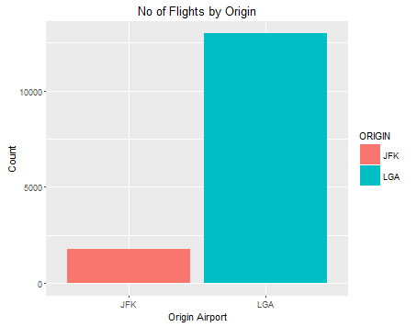
Exploratory Data Analysis
Origin Airport | %
JFK | 12%
LGA | 88%
Bar Plot for number of flights by origin

Slide 8
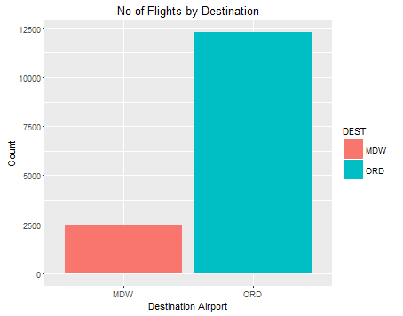
Exploratory Data Analysis
Destination Airport | %
MDW | 16%
ORD | 84%
Bar Chart Plot for no of flights by destination

Slide 9
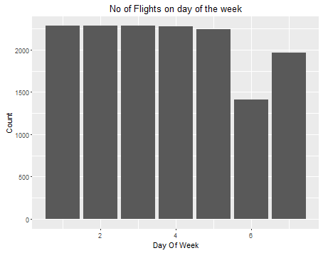
Exploratory Data Analysis
Day | %
Mon | 4.06%
Tue | 4.06%
Wed | 4.06%
Thu | 4.04%
Fri | 3.99%
Sat | 2.50%
Sun | 3.50%
Bar plot of Number of flights on day of the week

Slide 10
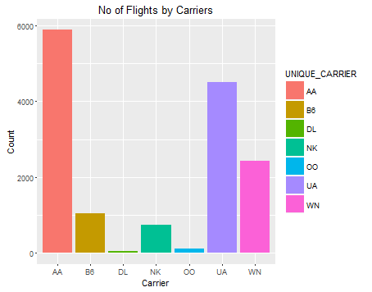
Exploratory Data Analysis
Airline | %
AA | 39.98%
B6(Jet Blue) | 7.02%
DL | 0.22%
NK(Spirit) | 4.95%
OO(SkyWest) | 0.71%
UA | 30.62%
WN(southwest) | 16.49%
Bar Chart Plot for no of flights by carriers

Slide 11
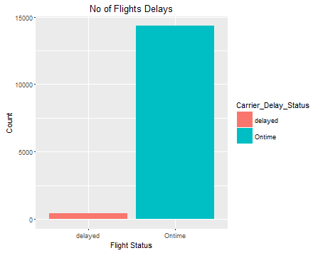
Exploratory Data Analysis
Delay Status | %
No Delay | 79%
Delay | 21%
Bar Chart Plot for no of flight delays.

Slide 12
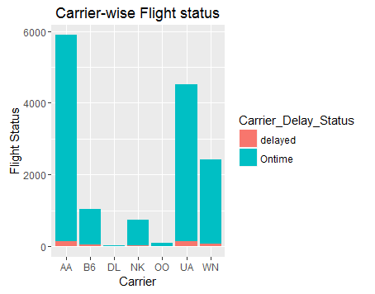
Exploratory Data Analysis
Airline | %
AA | 34.31%
B6 | 8.19%
DL | 0.00%
NK | 8.88%
OO | 0.22%
UA | 30.43%
WN | 17.97%
Bar Chart for carrier wise flight delays

Slide 13
Classification Algorithms
Logistic Regression
Naïve Bayes
Random Forest

Slide 14
Classification Algorithms:
Logistic Regression
Logistic regression predicts the probability of an outcome that can only have two values. The prediction is based on the use of one or several predictors (numerical and categorical).
A logistic regression produces a logistic curve, which is limited to values between 0 and 1.
Logistic regression is similar to a linear regression, but the curve is constructed using the natural logarithm of the “odds” of the target variable, rather than the probability.

Slide 15
Classification Algorithms:
Logistic Regression
Combination | Accuracy %
Carrier_Delay_Status~DAY_OF_WEEK | 97.29
Carrier_Delay_Status~DAY_OF_WEEK+ ORIGIN | 97.72
Carrier_Delay_Status~DAY_OF_WEEK+ORIGIN+ARR_TIME | 98.14
Carrier_Delay_Status~DAY_OF_WEEK+ORIGIN+ARR_TIME+DEST+Unique_CARRIER | 99.21
The feature combination of DAY_OF_WEEK + ORIGIN + ARR_TIME + DEST + Unique_CARRIER

Slide 16
Classification Algorithms:
Naïve Bayes
Naive Bayes classifiers are a family of simple probabilistic classifiers based on applying Bayes theorem with strong (naive) independence assumptions between the features.
They can handle both continuous and discrete predictors; it assumes a distribution (can be chosen) for the continuous predictor.

Slide 17
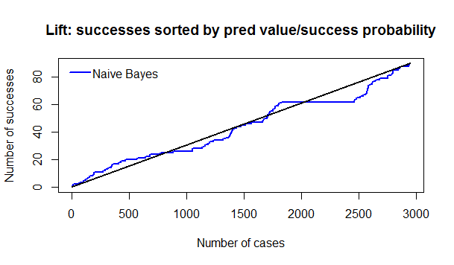
Classification Algorithms:
Naïve Bayes
The accuracy for Naïve Bayes is 98.7 %

Slide 18
Classification Algorithms:
Random Forest
Random Forests classify instances by creating many decision trees and then combining the results across these trees to make a prediction.
Random Forest has many advantages over single decision trees. For example, it can handle many input variables, both categorical and continuous.
It also “runs efficiently on large databases”. (Breiman & Cutler)
The accuracy for the model created using Random forest is 99.47%

Slide 19
Limitations
As the number of flights that were delayed were much less compared to the number of flights that were not delayed, we get a very high accuracy rate
Delay can be due to other factors which are not dependent on the carrier.
For our analysis we have not taken into consideration the weather delay, but if we had considered it our results could have been different.

Slide 20
Conclusion
Out of all the three classification algorithms used random forest gives us the best result with an accuracy of 99.47 %

Slide 21
Thank You!
Questions?

